Slide 1


Slide 2


Slide 3
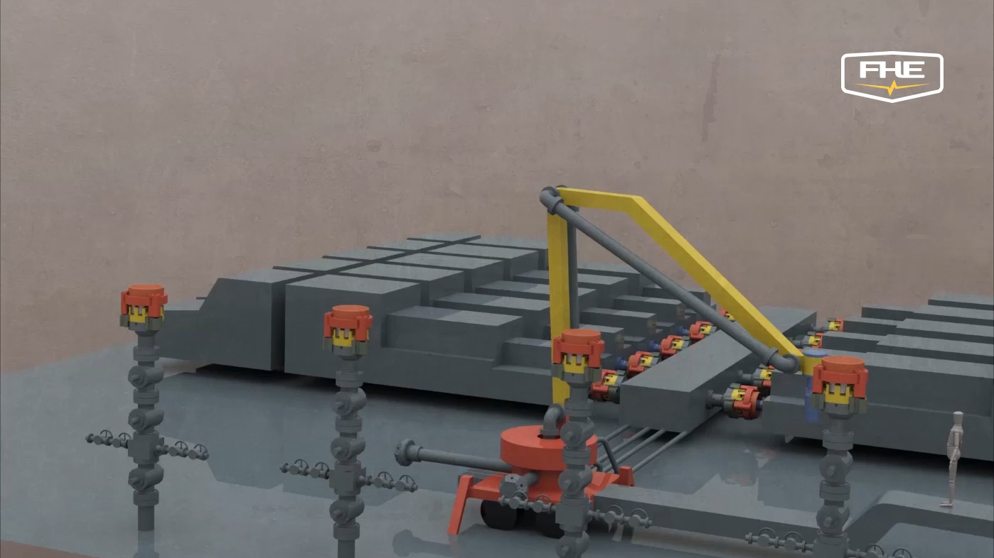



Slide 4

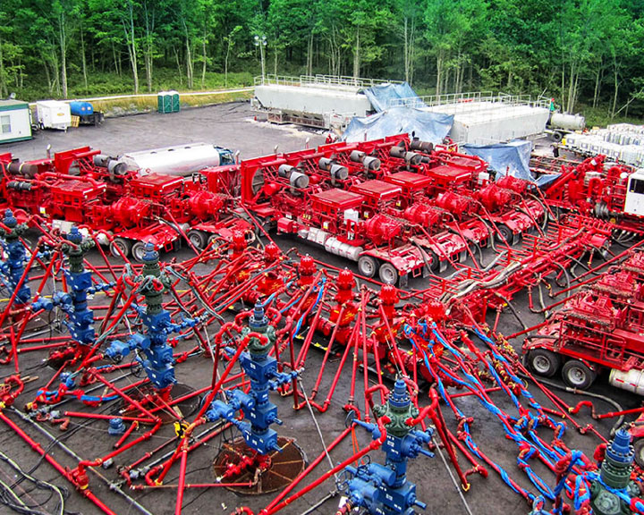
Current Frac Setup
Dangerous, inefficient, costly, time-consuming, and overgrown.
Whip stops are used to prevent pipes from causing fatal injuries to workers after they burst. Despite being inspected, frequent injury occur due to the amount of equipment present.
Before operations can begin, crews arrive at least 2-days early to set up the piping prior to trucks arriving. This can take longer if an operation is not able to find enough quality labor for the job.
All frac iron needs to be tested every 3–6 months resulting in extended downtime and costly inspections.
Zipper manifolds are costly to lease and hard to find with few in the market available making downtime to this piece devastating to the operation.
Goat heads are another costly piece of equipment that requires frequent testing.

Slide 5
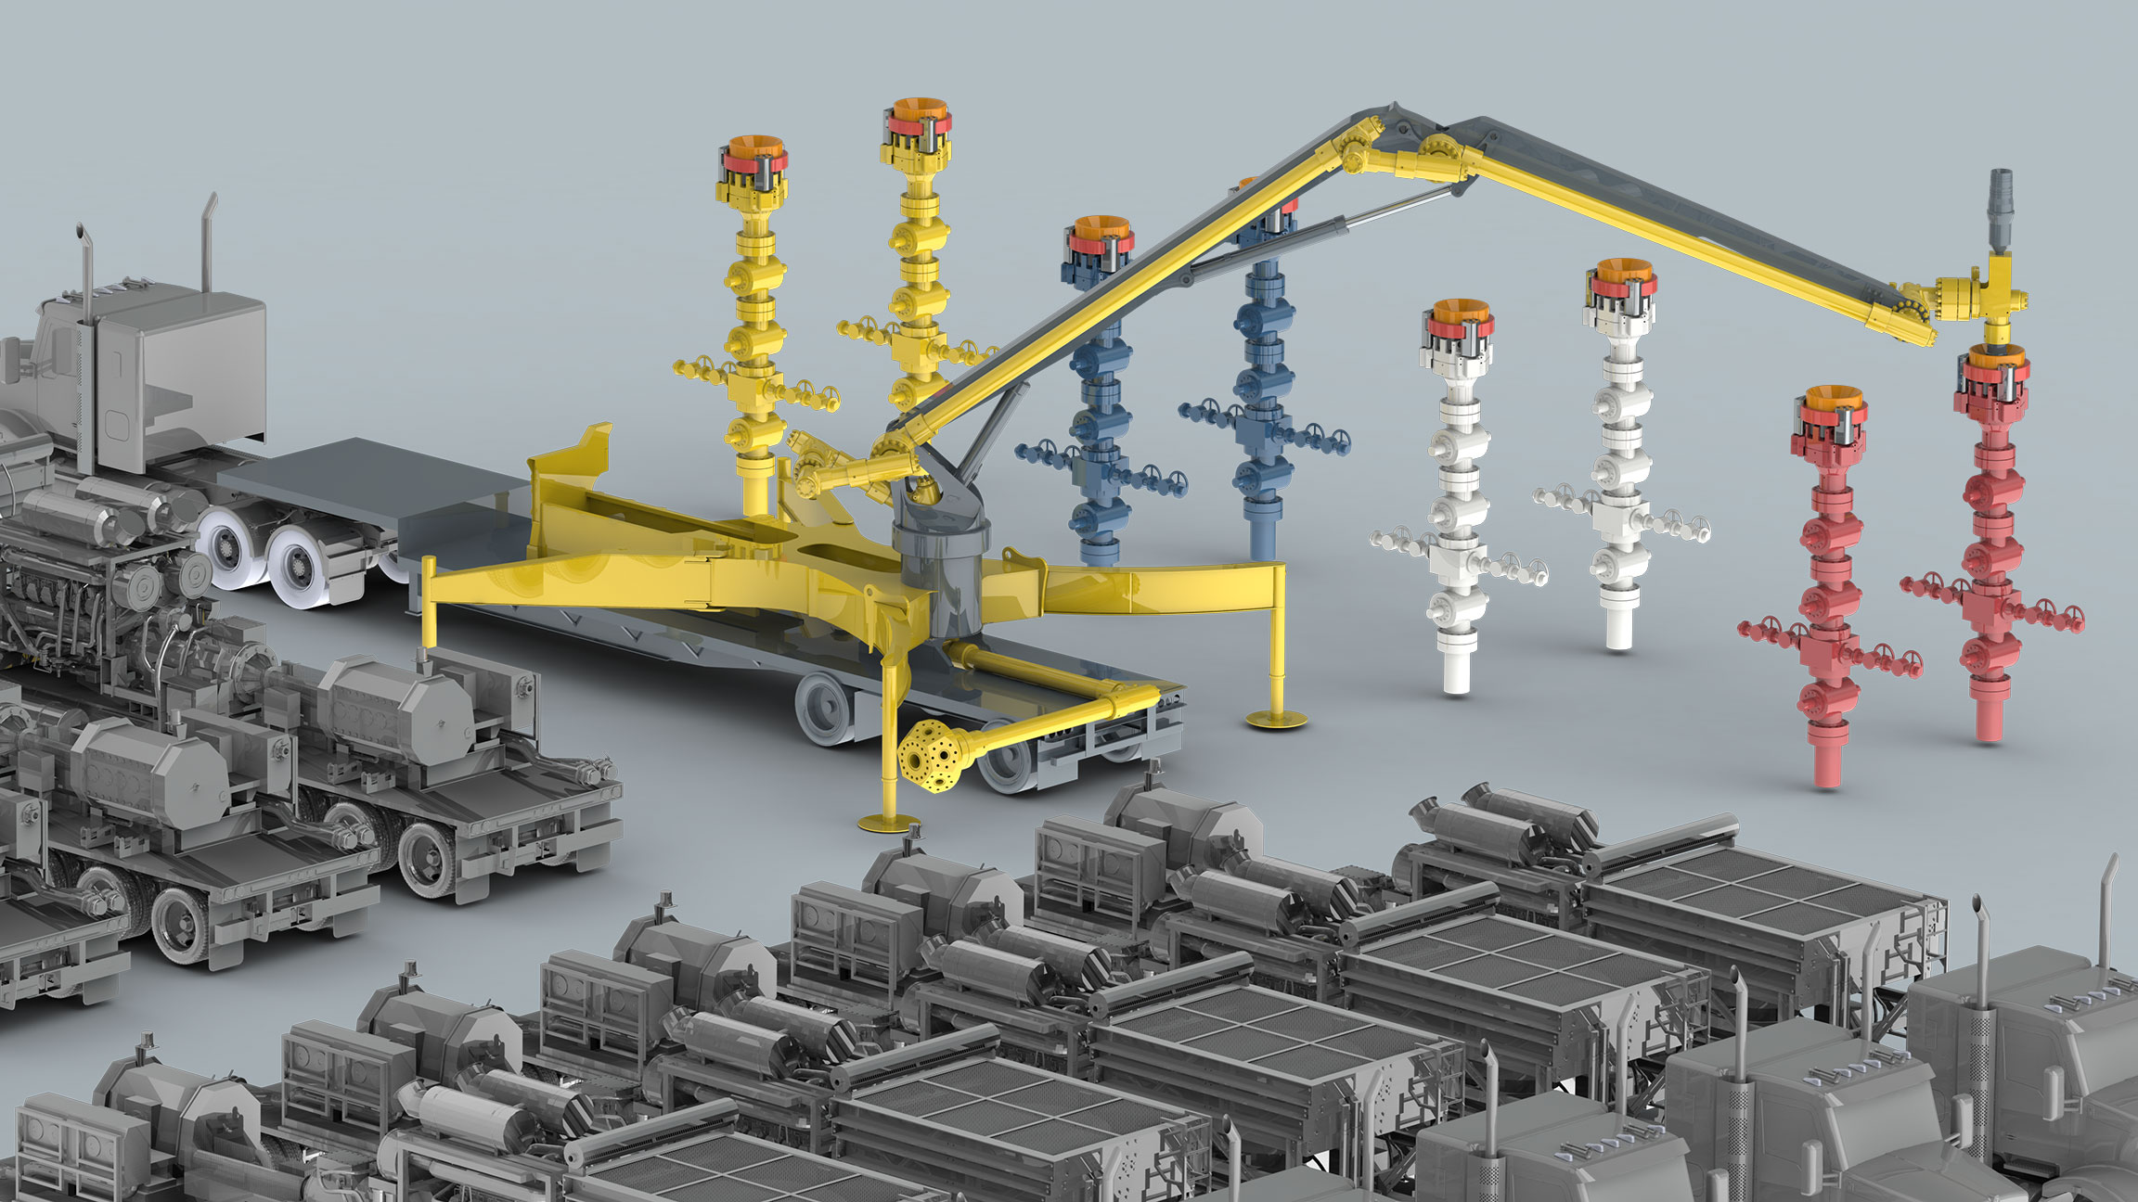

Slide 6
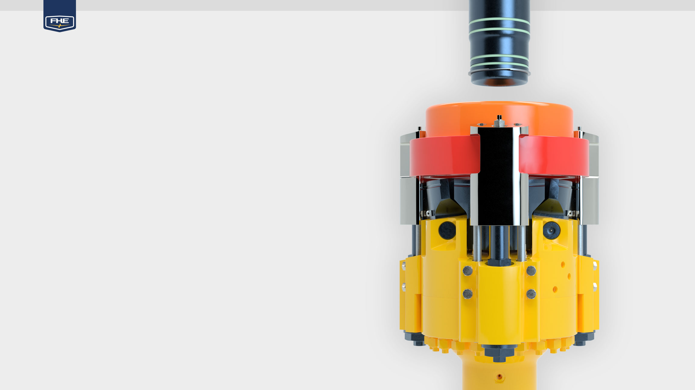
FHE FracLock
Remotely Operated Universal Wellhead Connection
Works with Wireline, Frac, and Coiled Tubing
Removes All Personnel from Danger Zones
Increases Accessibility to Wellheads
7” Interior Diameter
15K psi Working Pressure
Capable of 130 bpm Fluid Transfer
Quick Test Functionality

Slide 7
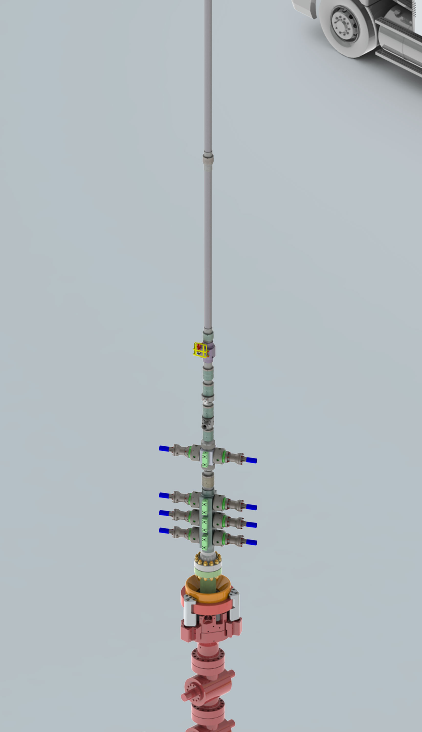
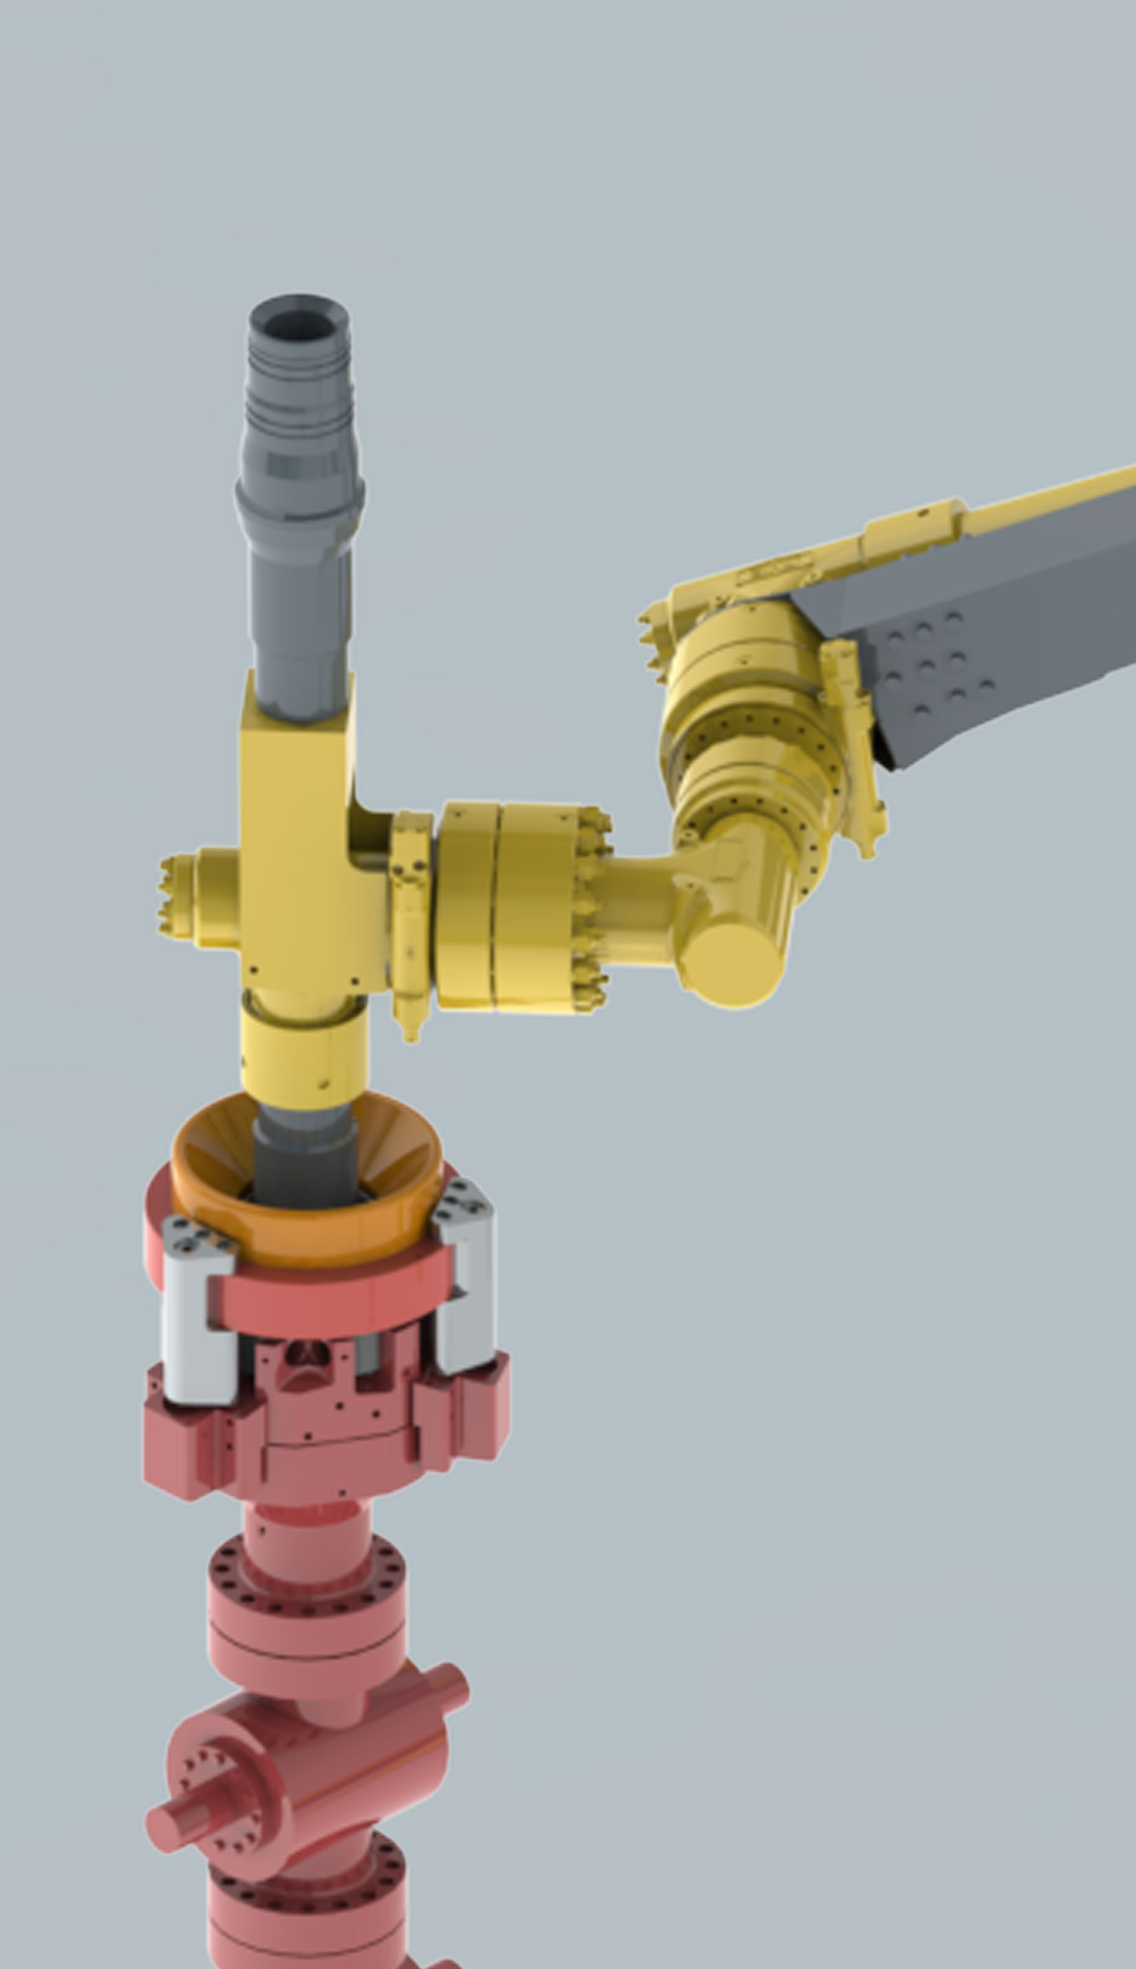
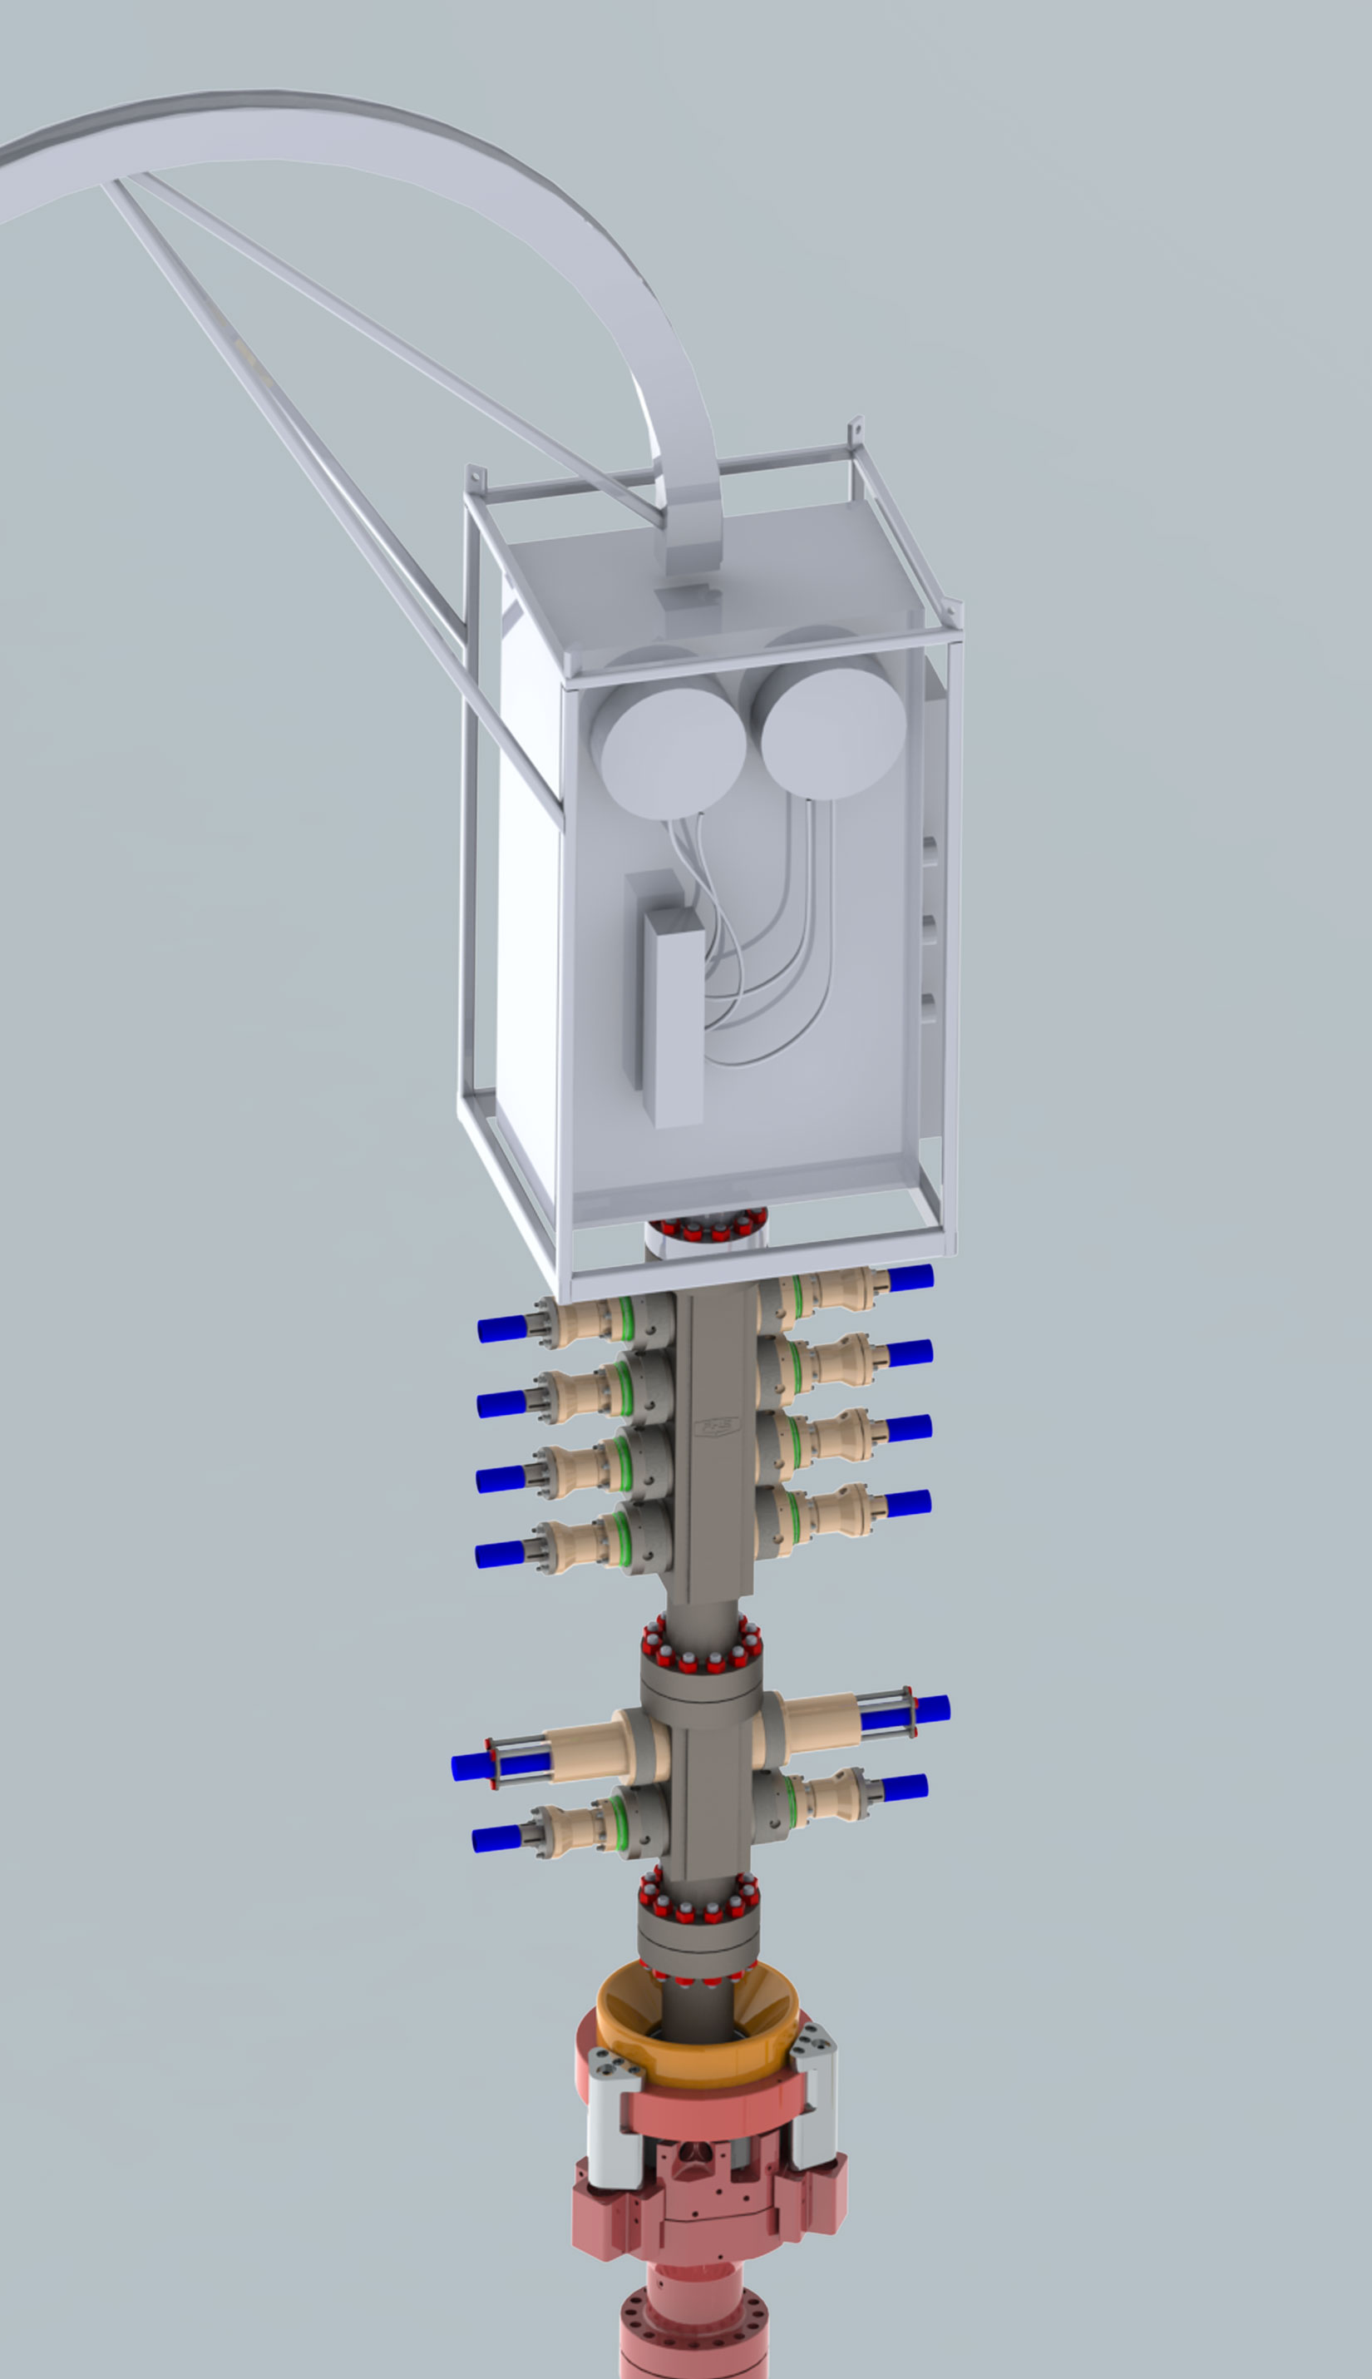

Slide 8
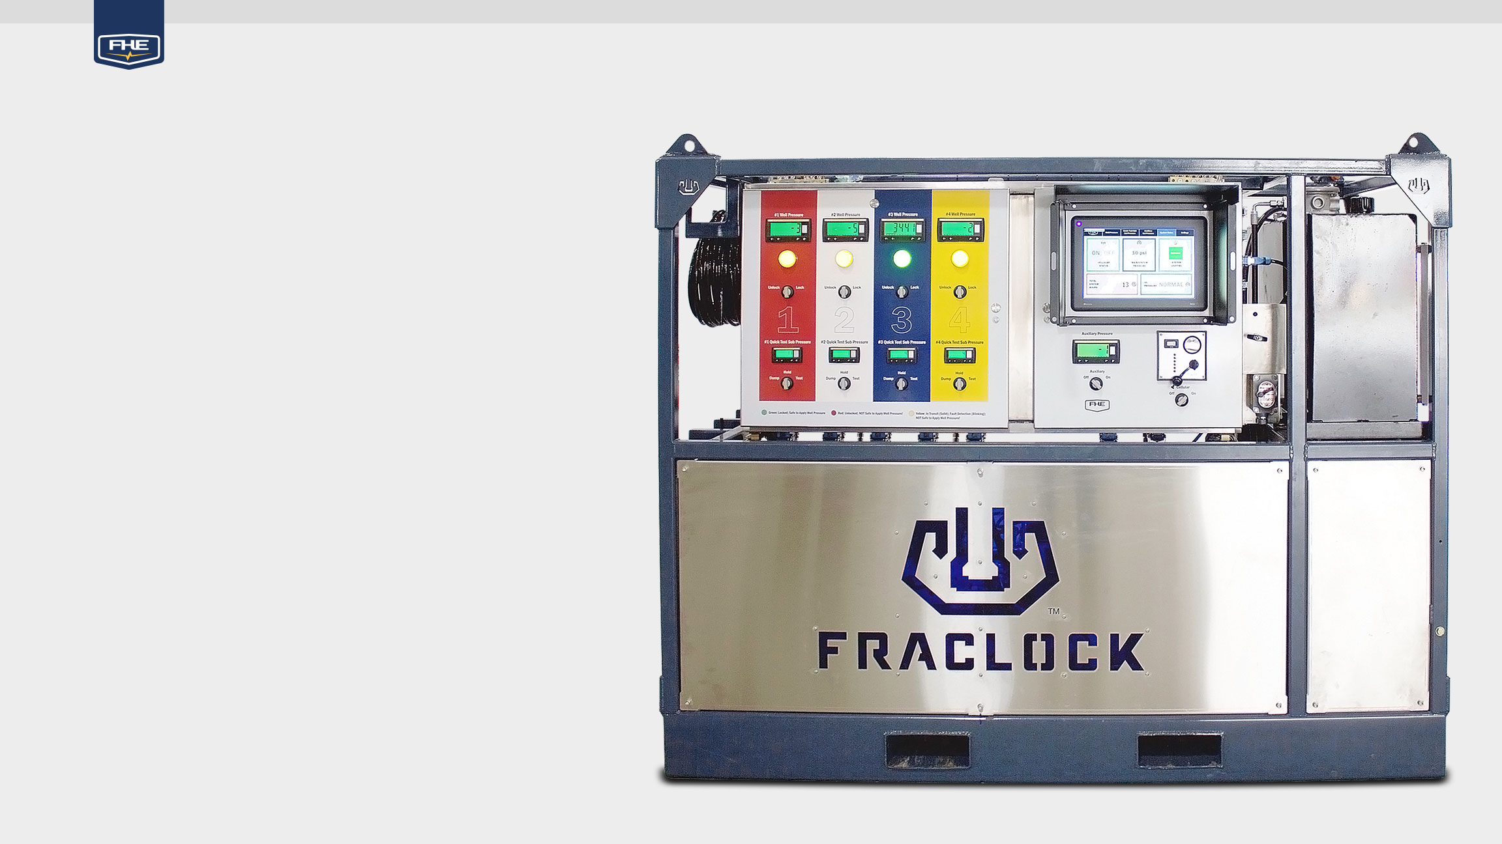
FracLock Control Unit
Well Monitoring System Prevents Unintentional Unlocking When Well Pressure Registers
Safety Light Indicators Visually Shows If FracLock is Locked or Unlocked
Spring-Loaded Switches Must Be Manually Held Until Function is Completed
Simplified Controls with Touch Screen
Remote Access to Real-Time or Stored Data Through Secure Cellular Network
Offsite Diagnostics
Operates and Monitors Up to 4 FracLocks

Slide 9
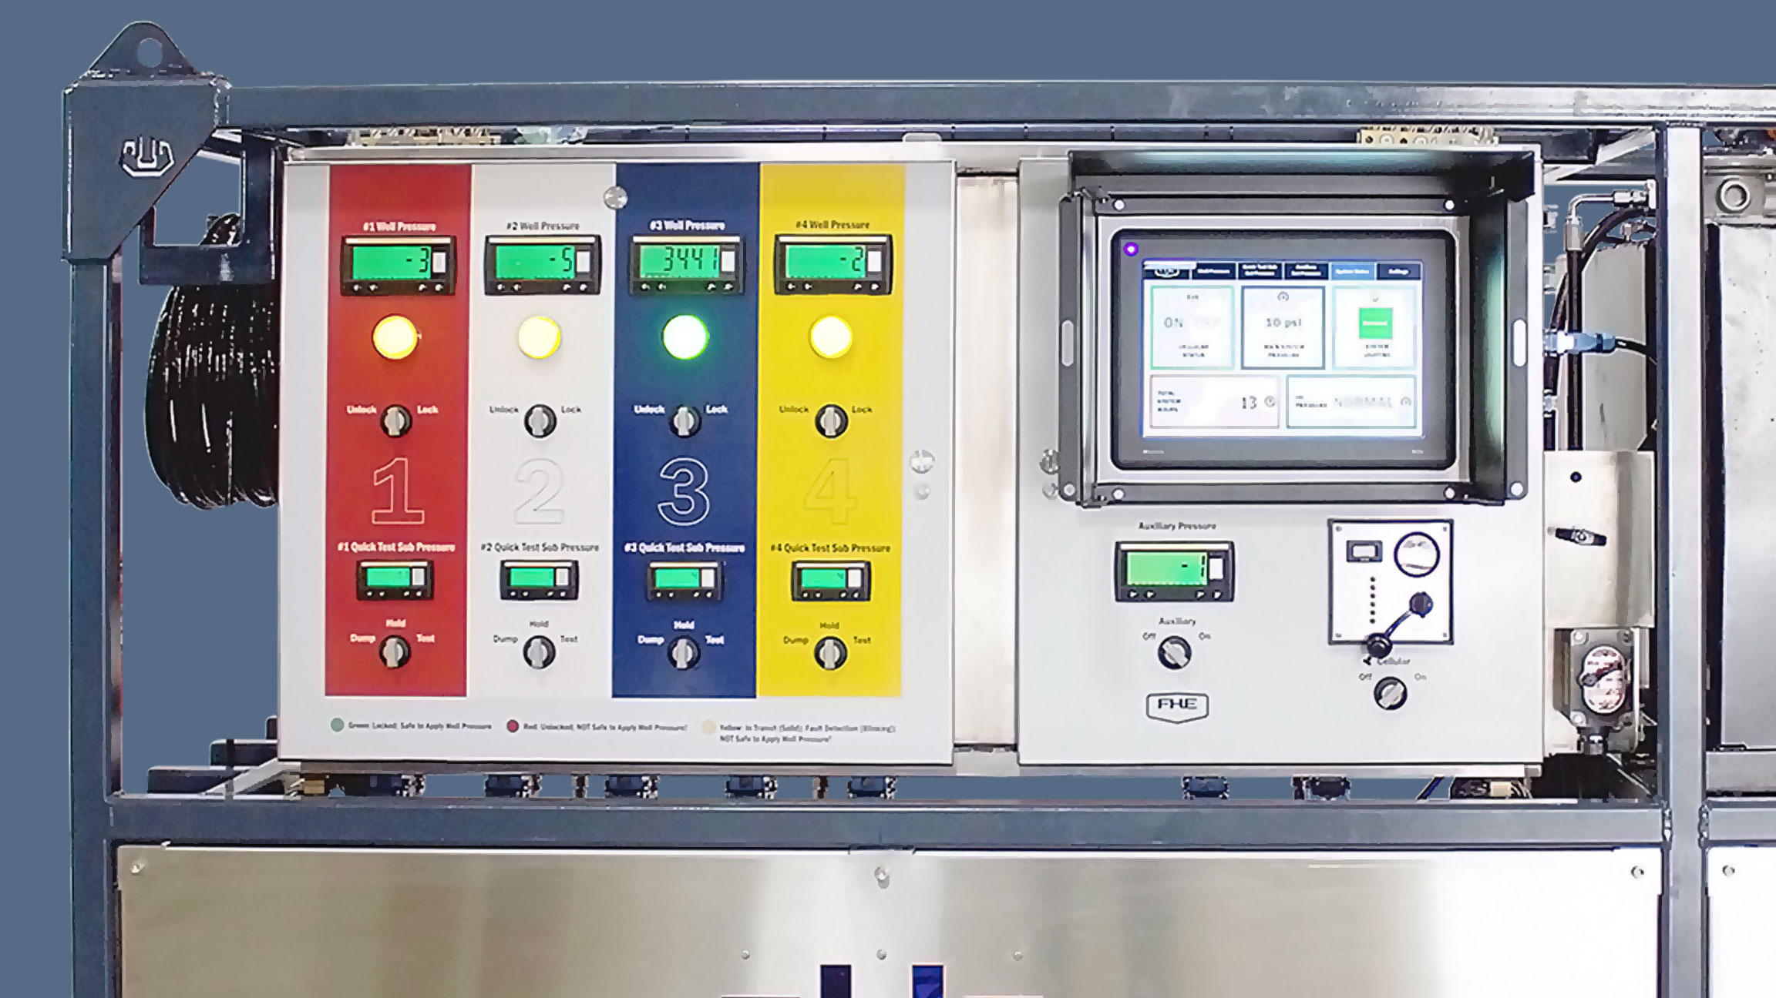
Digital Well Pressure Monitoring Display
HMI Interface
Safety Light Indicators
FracLock Unlock/Lock
Diesel Engine
Controls
Quick Test Sub Controls
and Pressure Displays
Auxiliary Function with Pressure Controls
Cellular
On/Off
Emergency
Shut Off

Slide 10
HMI Touch Screen Interface
Displays All 4 Well Pressures Simultaneously
Allows Operators to Set Desired Pressures for Quick Test and Auxiliary Functions
Intuitive Interface for Ease of Use with Large Touch Areas
Prominent Main Menu Gives Access to Critical System Information

Slide 11
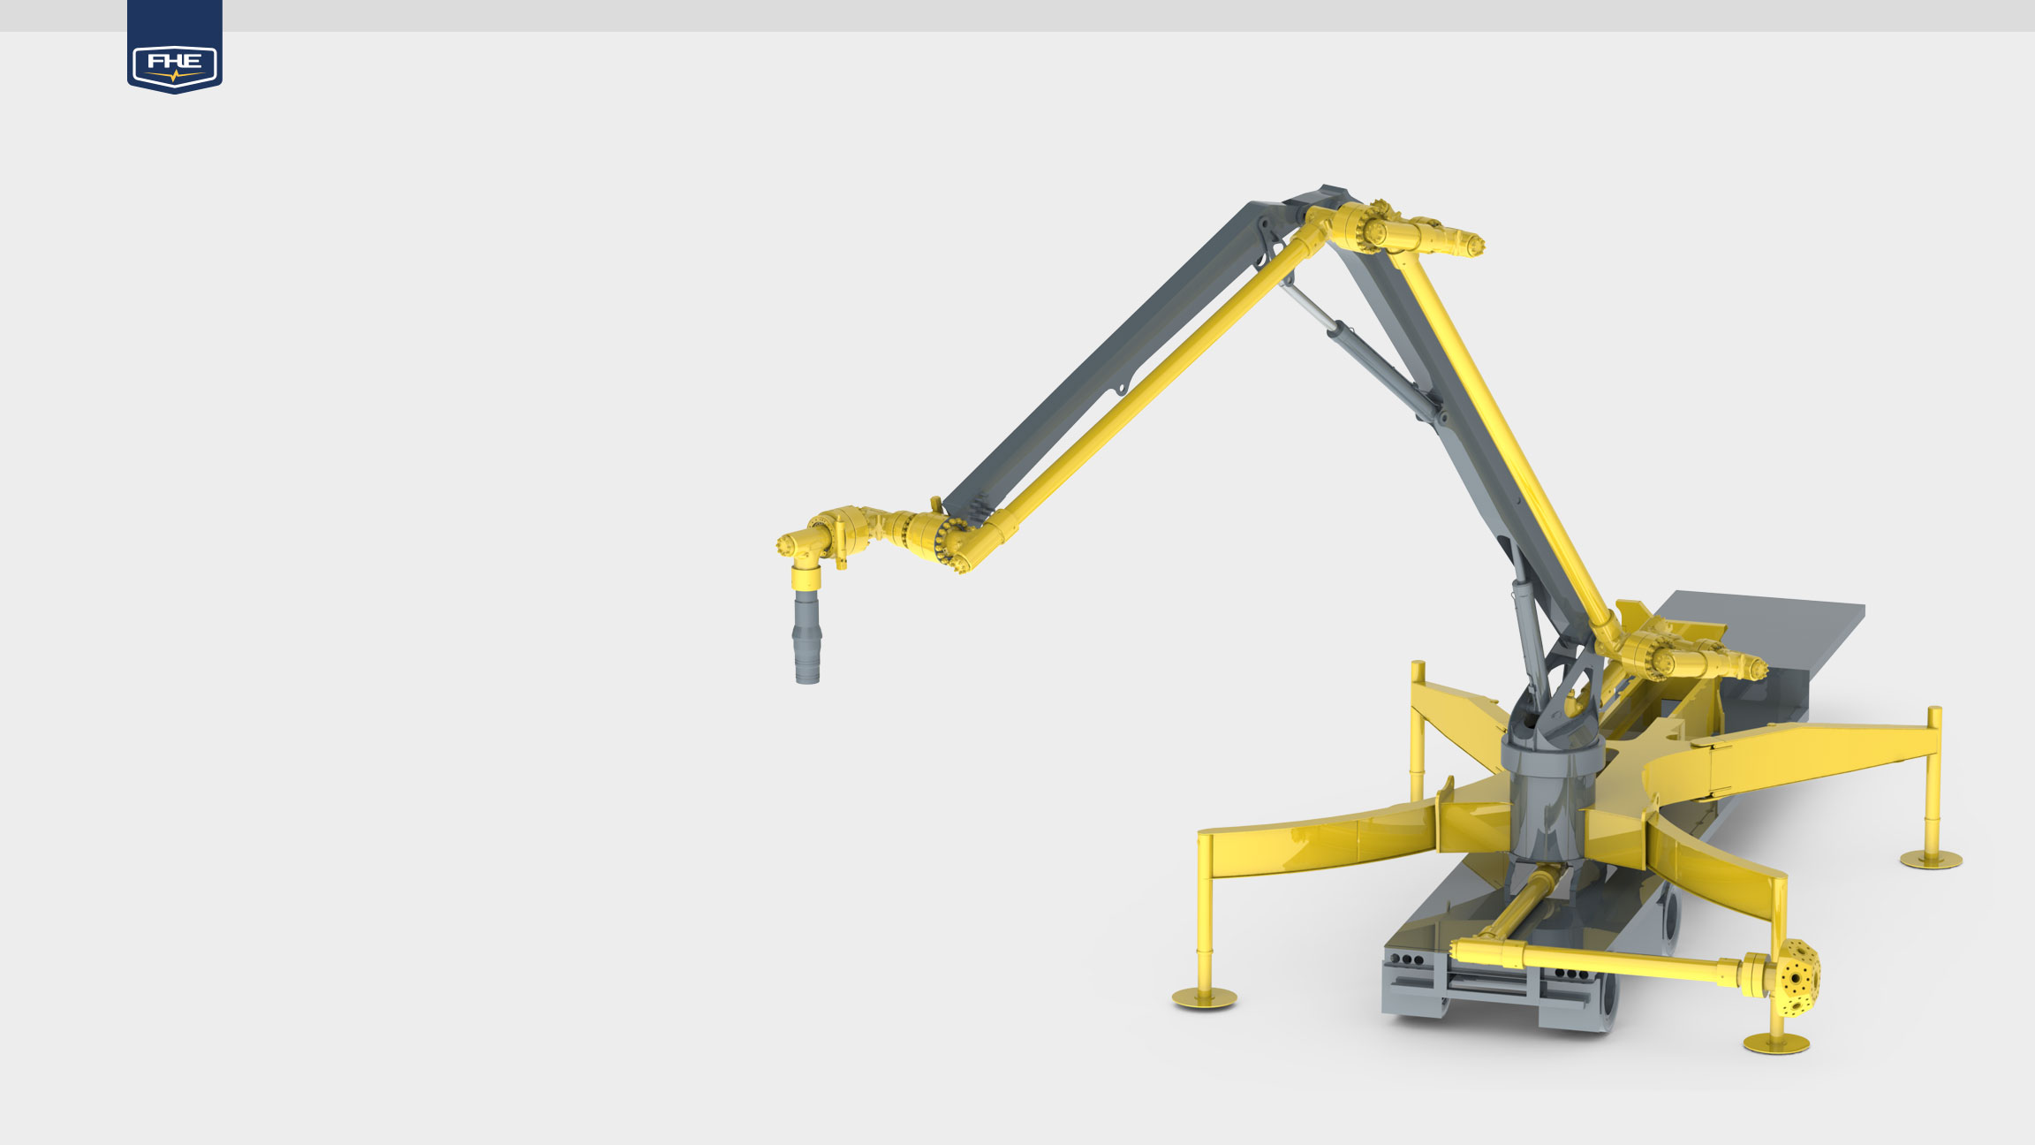
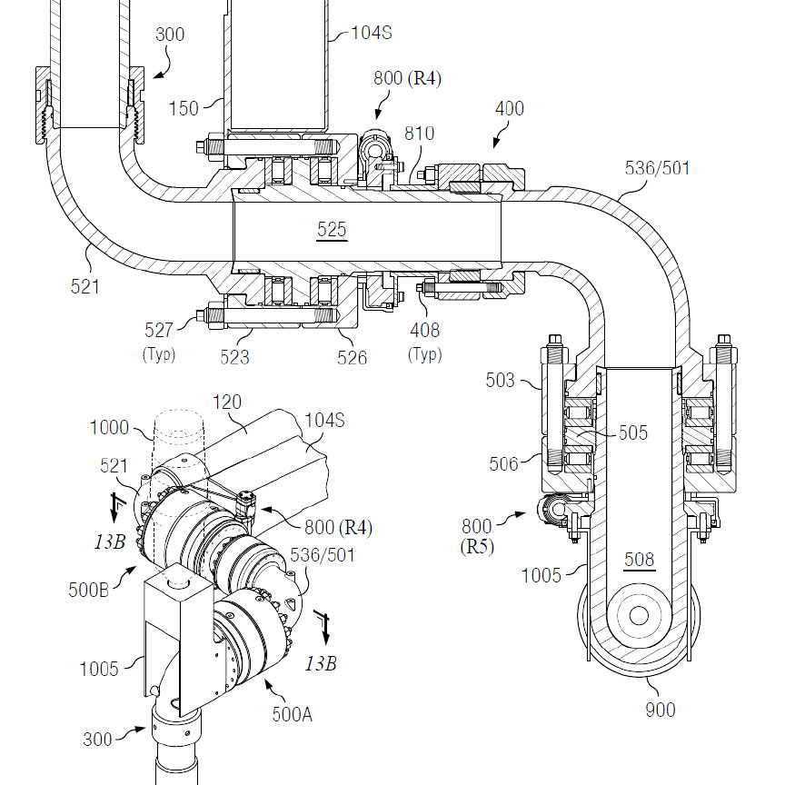
Articulated Arm
Eliminates Overgrowth of Frac Iron and Additional Equipment
Limits Exposure of Employees to Dangerous Situations
Rated for C1D1 Use
4 Outriggers for Maximum Stability
Quickly Moves Between Wells Maximized Reach with 5 Axes of Rotation
Integrated System for Rapid Deployment and Tear Down with Auto Transport Setting
Powered by a Designated Diesel Engine
Mounted on 50’ Trailer with Estimated Weight of 88,000 lbs

Slide 12
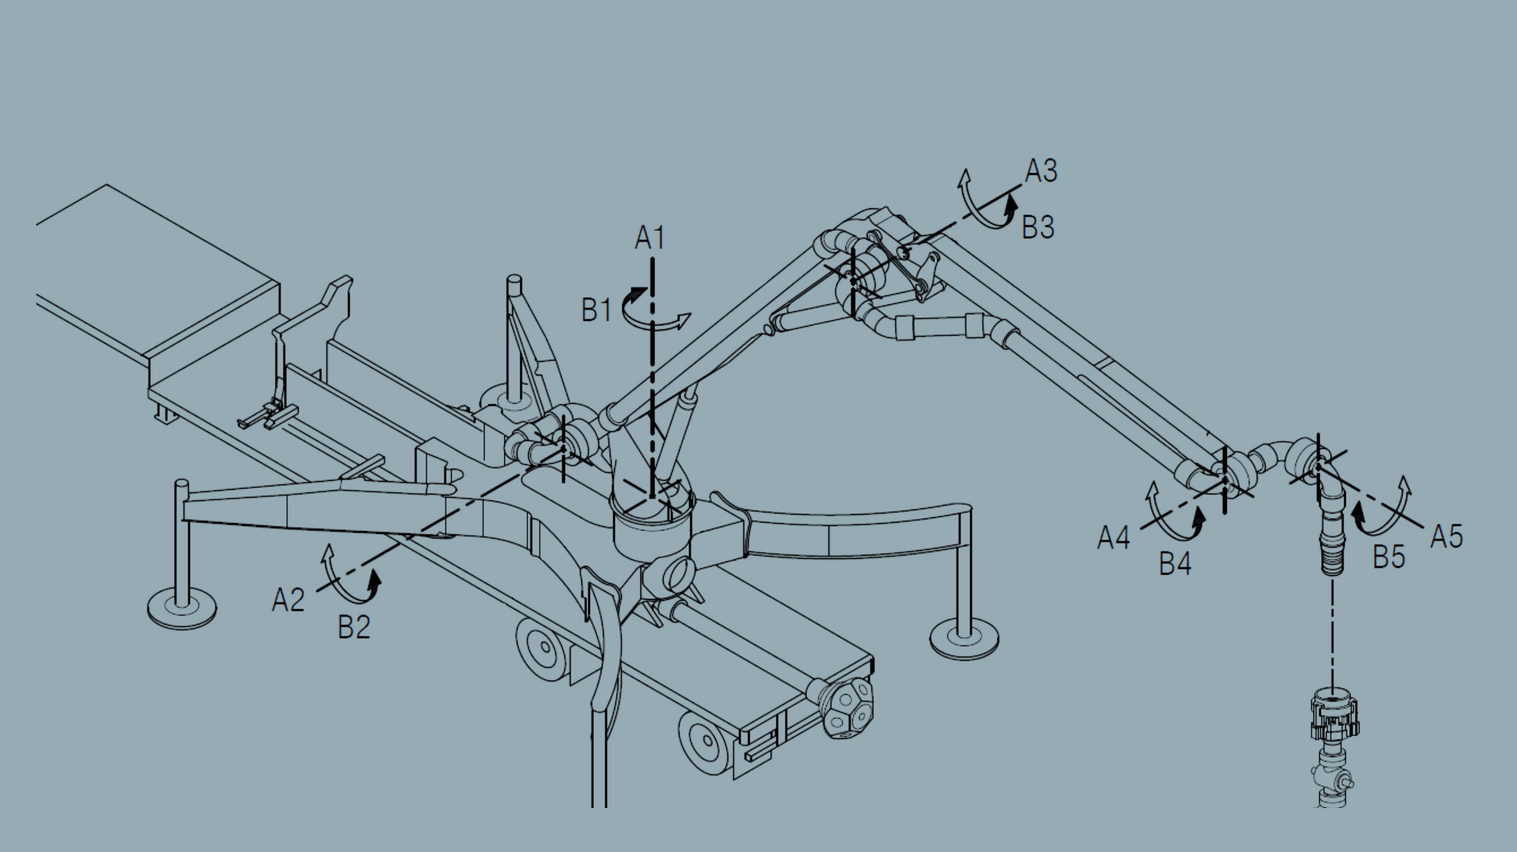

Slide 13
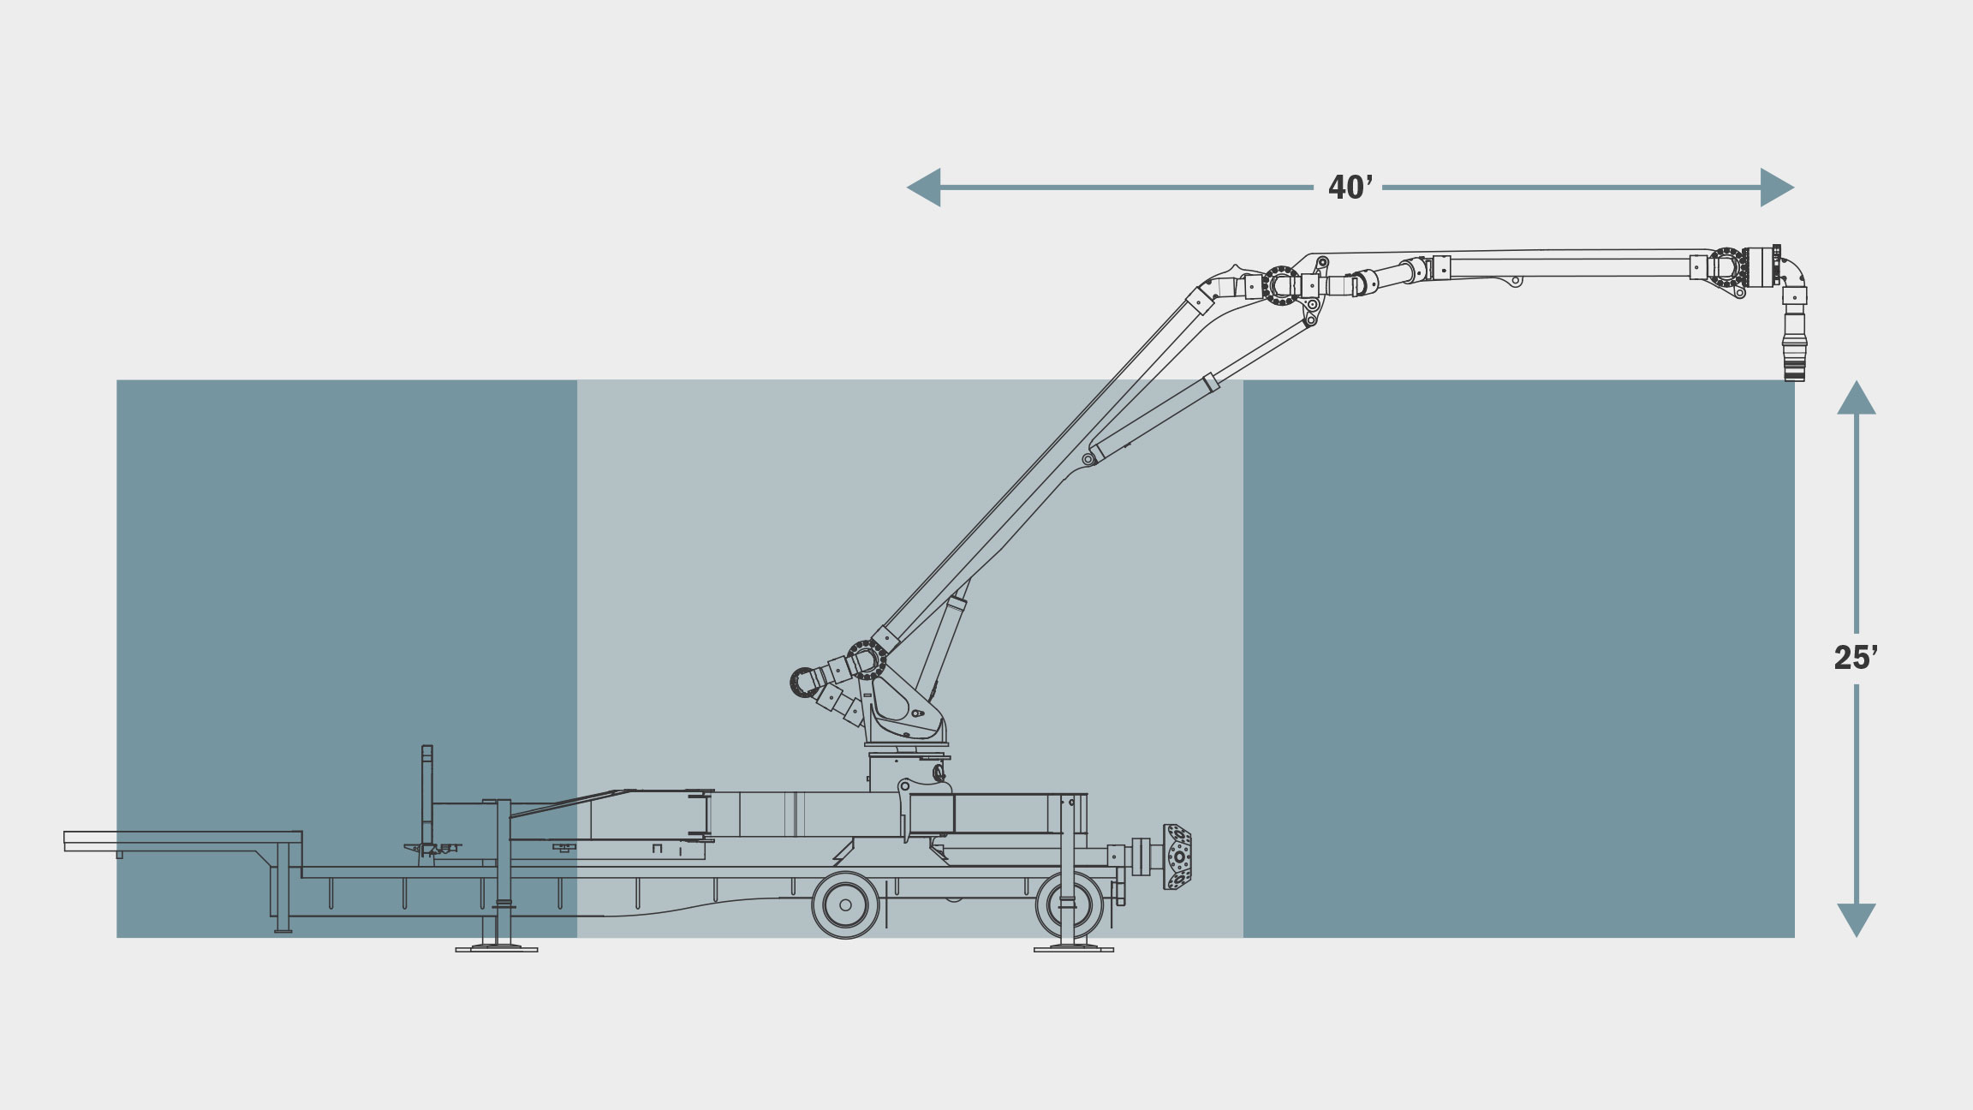

Slide 14
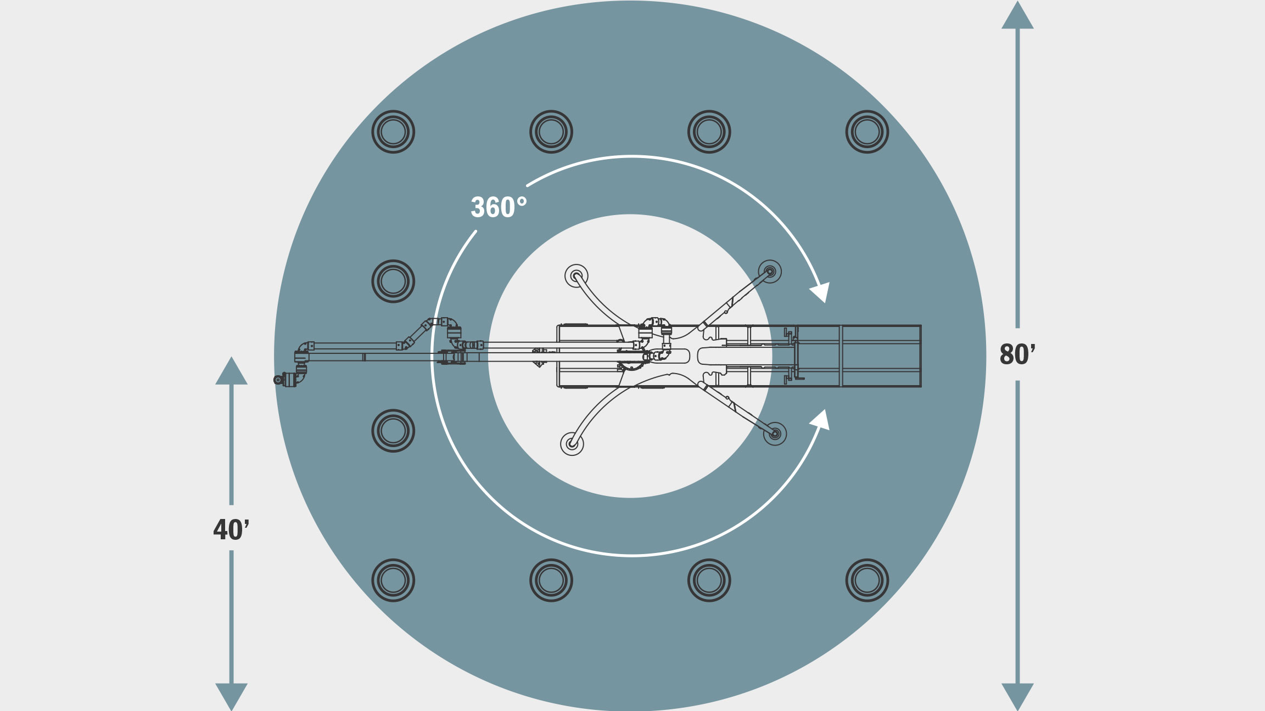

Slide 15
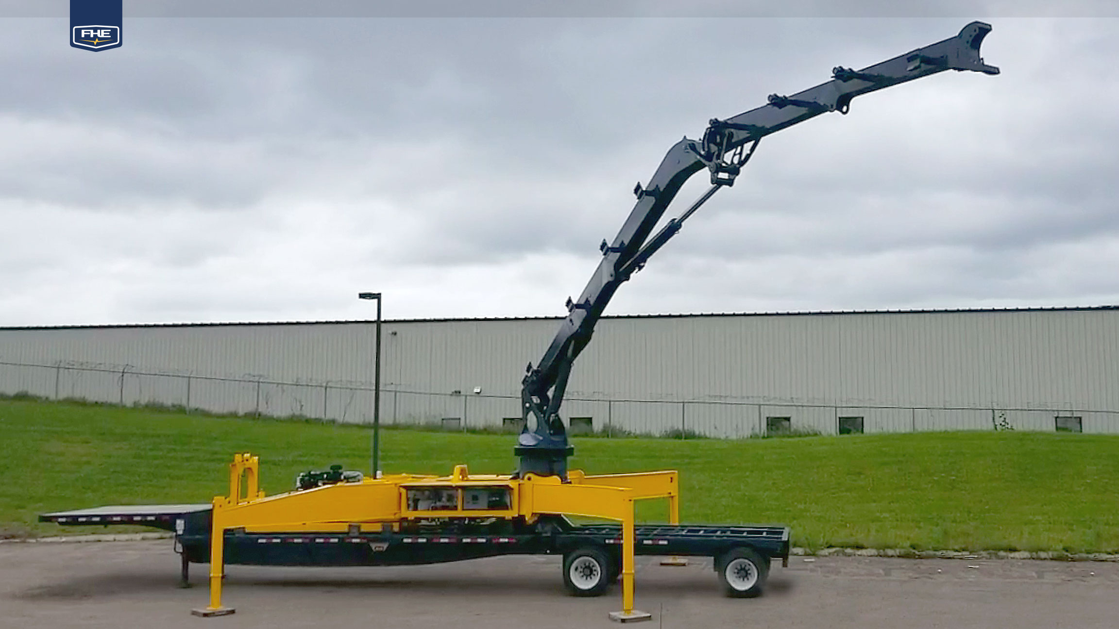

Slide 16
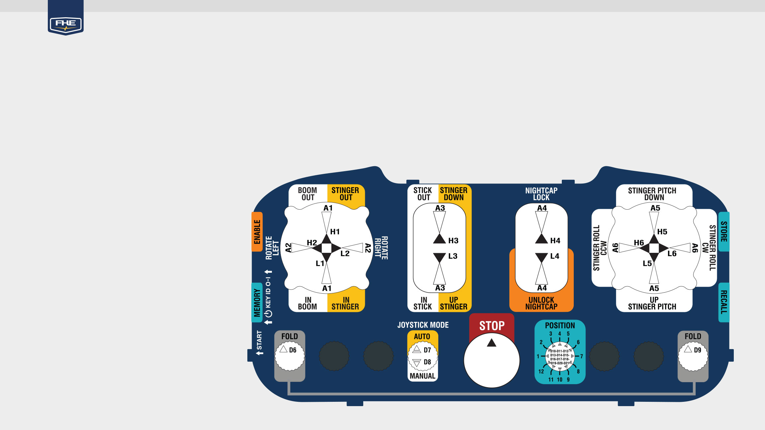
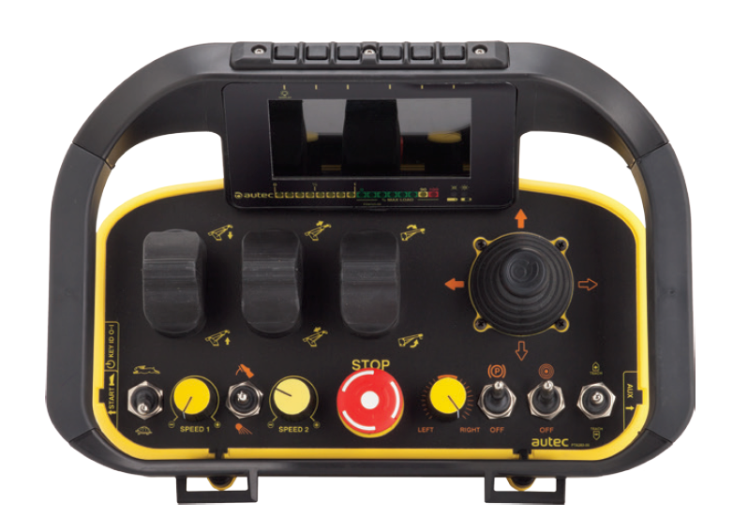
Articulated Arm Remote Controls
Custom-Designed Remote Control For Simple Operation
12 Programmable Position Recall
Preset Height Required for Position Recall
Remote Controls Allows Operator to View Targeted FracLock from Various Angles and Unobstructed View
Auto Setting Keeps Crossover Plumb to the Wellhead
Manual Setting Allows Complete Control for All 5 Axes
Backup Controls Located at the Trailer
”Fold” Function Returns the Articulated Arm to Transport Ready Position

Slide 17
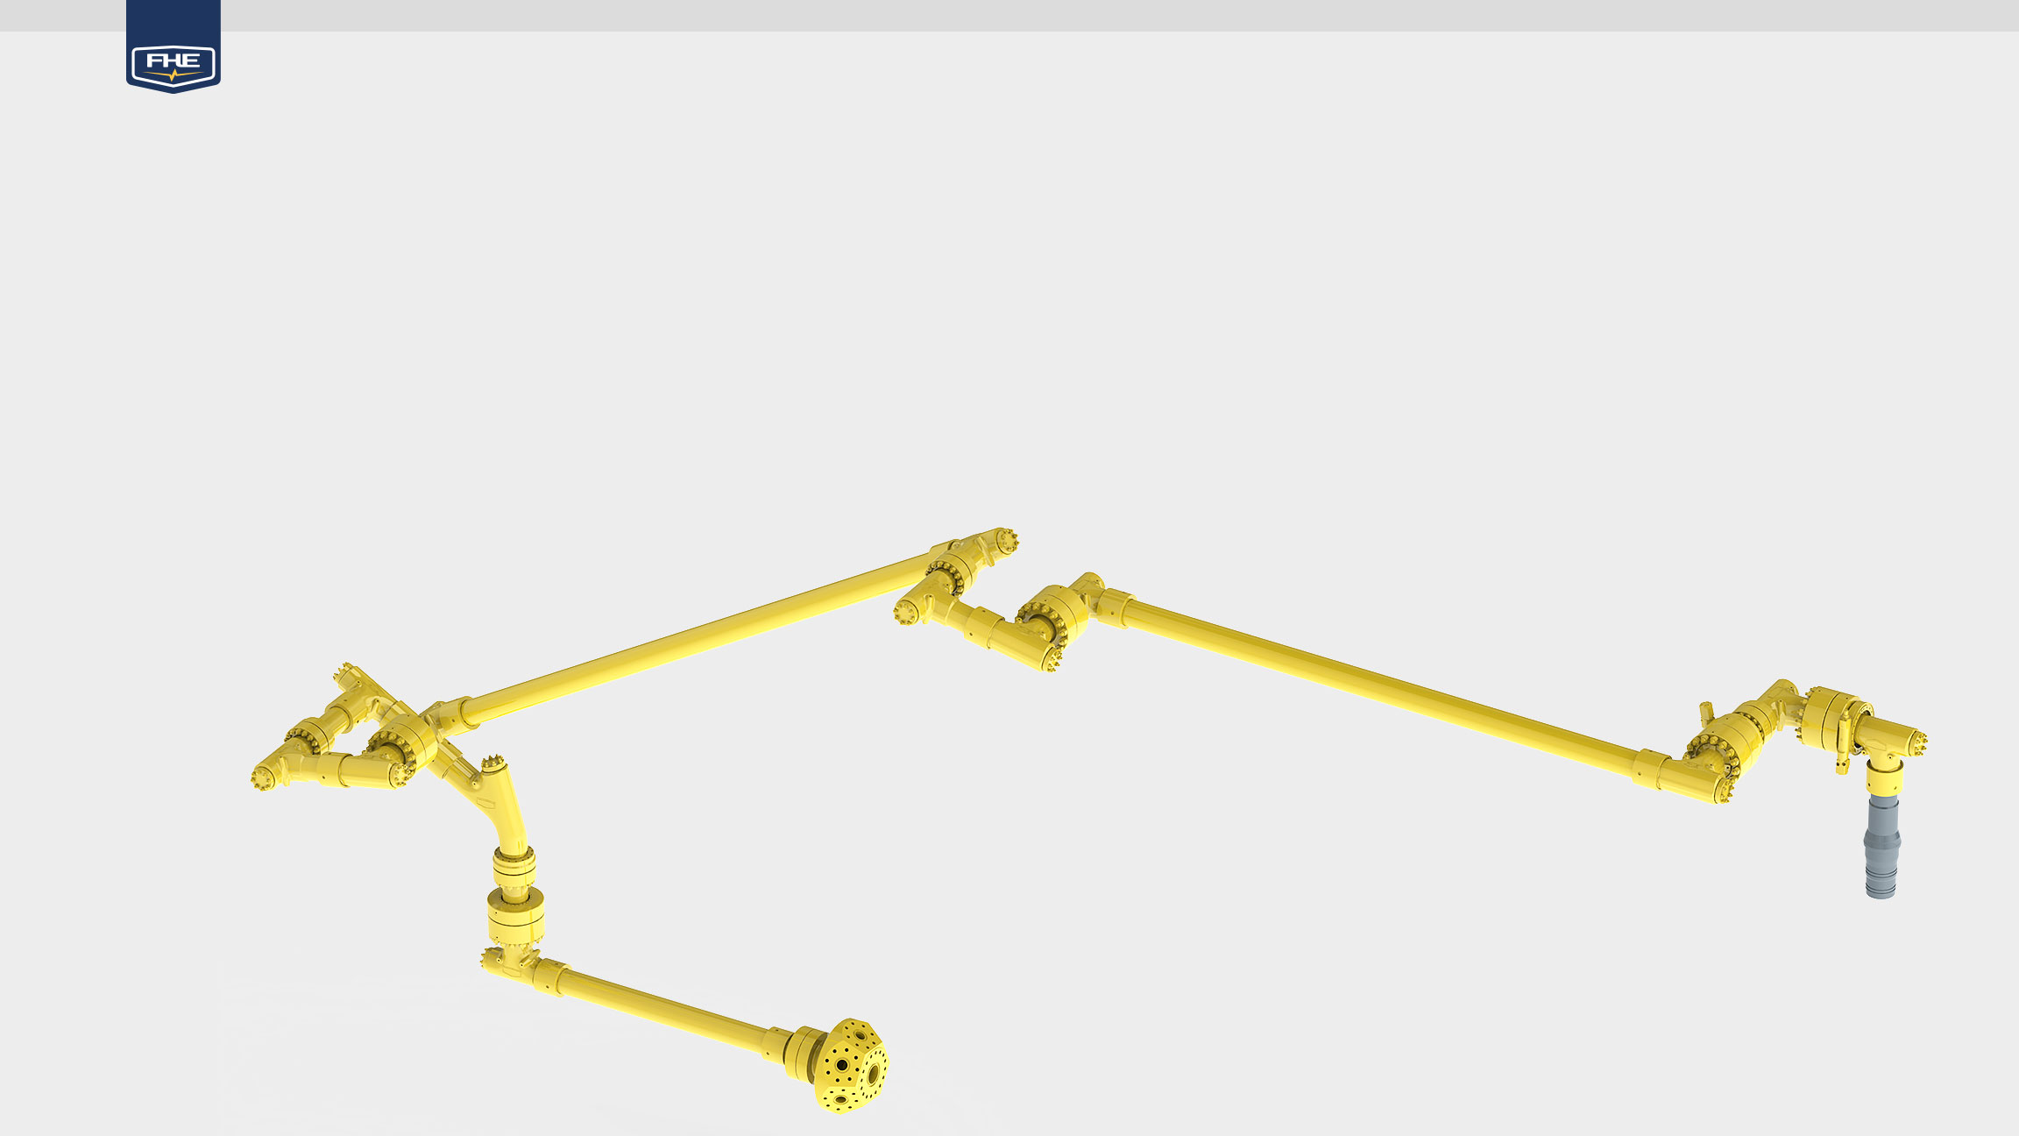
Dynamic Flow Iron
Patented, Lightweight Elbow and Swivel Designs Allows Equipment to Be Quickly Connected and Safely Contain Well Pressured During Operations
7” Internal Diameter for Maximum Flow
15K psi Working Pressure for Versatility
Capable of 130 bpm Fluid Transfer
In Depth Analysis, Simulations, and Testing Maximized the Entire Flow Path for Higher Put Through Rates
Trailer Connection is Module for Complete Adaptability

Slide 18
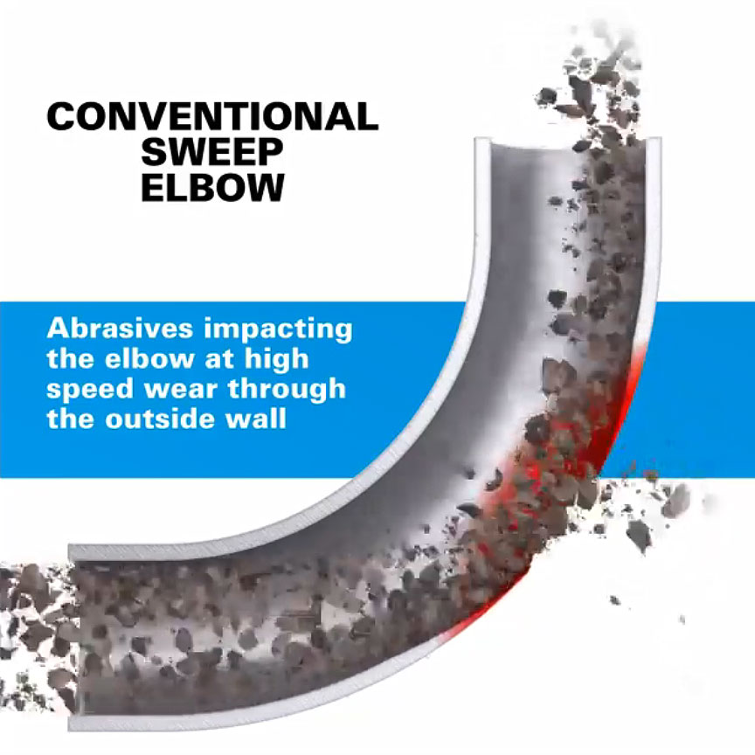
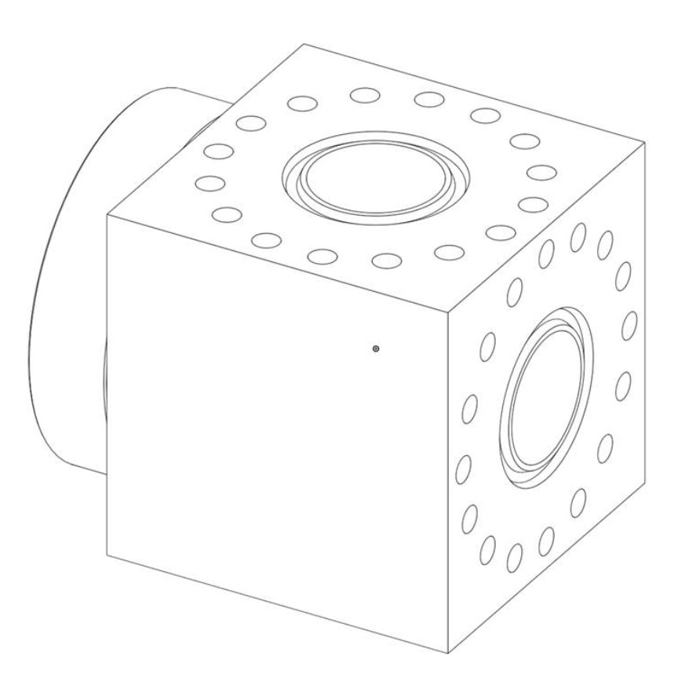
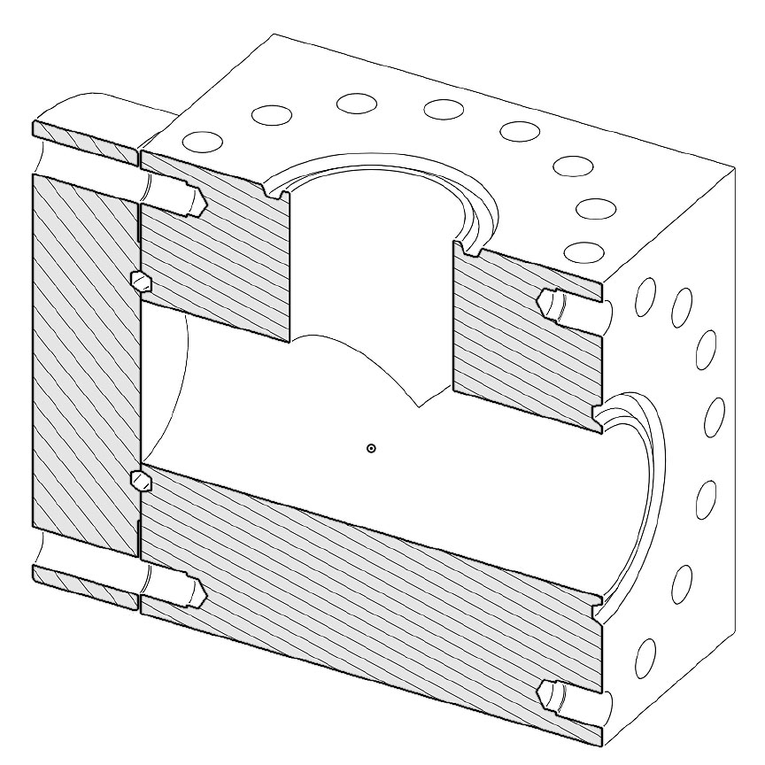
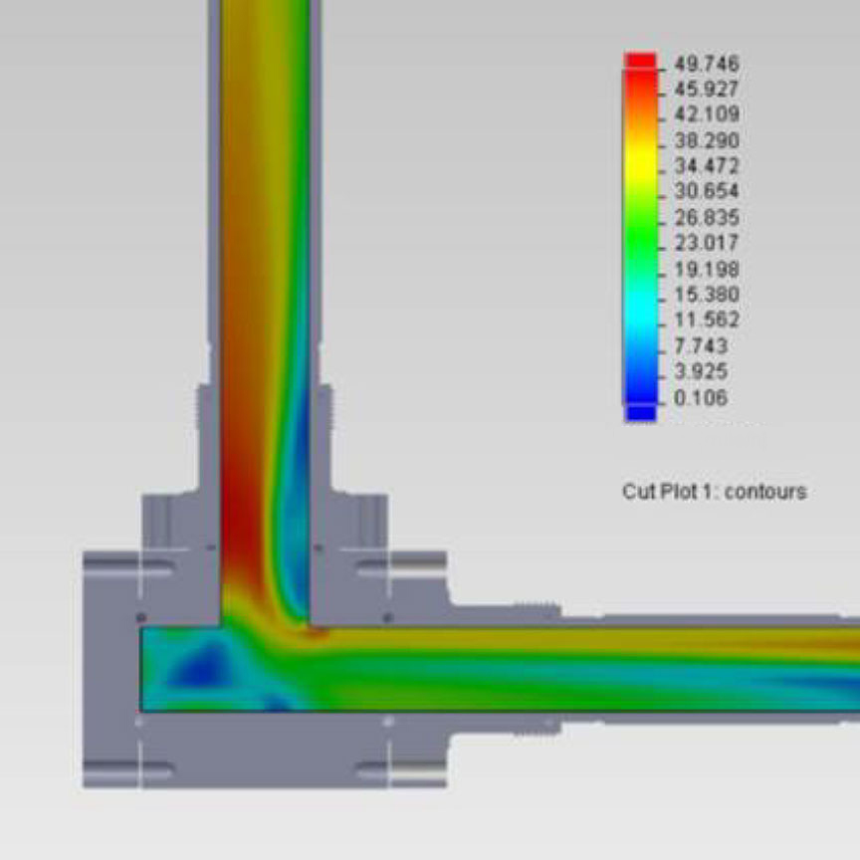
Current Flow Iron Technology
Swept Elbows (Washout)
Tee Blocks (heavy (2,400 lbs.) and Inefficient Flow Path)

Slide 19
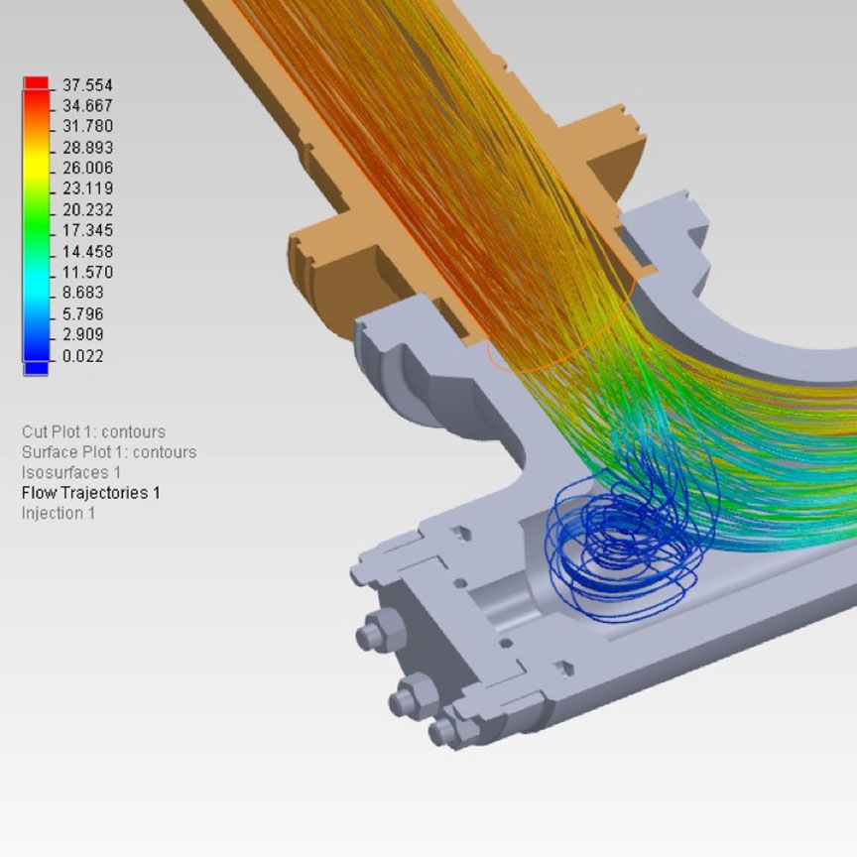
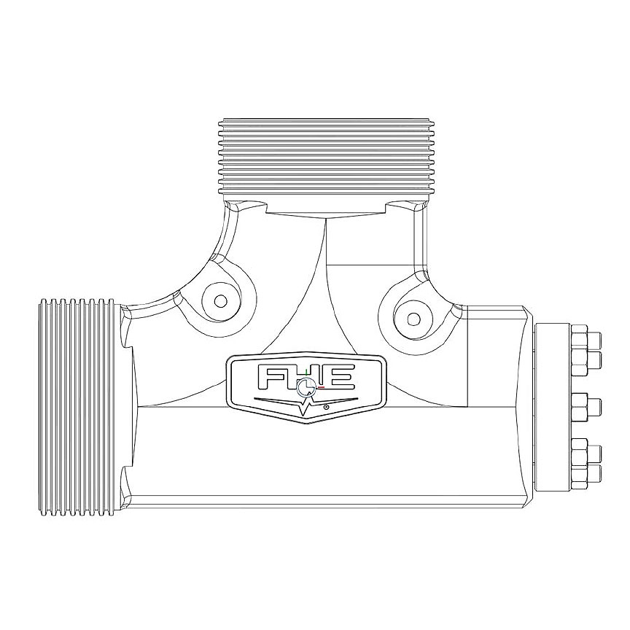
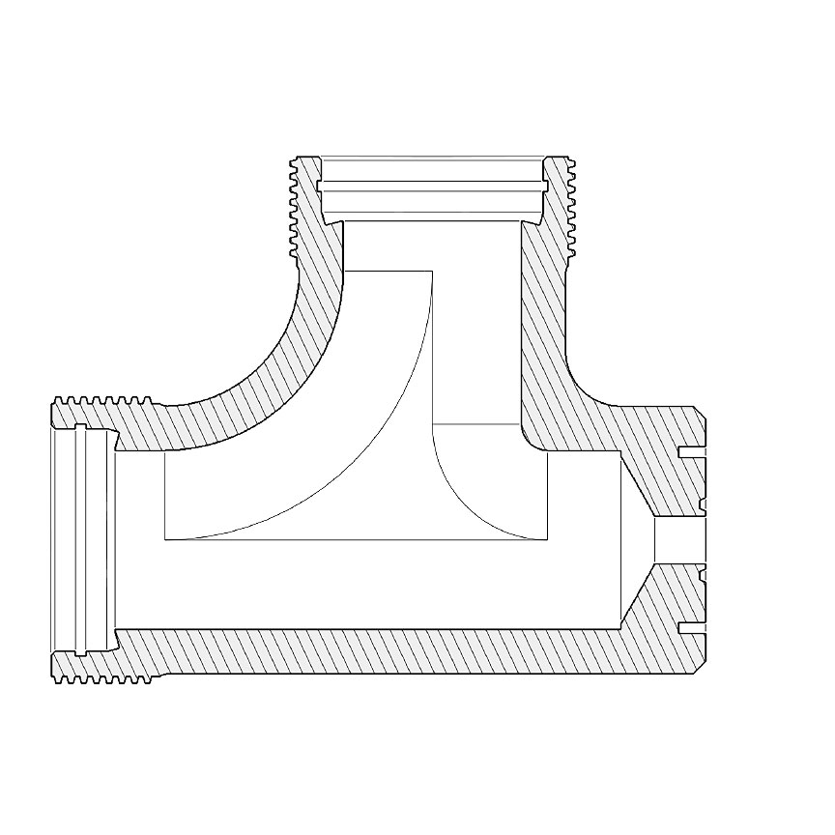
Hydraulic Dampening Elbows
Tee Initially Packs with Sand Creating a Vortex Where It Slowly Moves Out
Continuous Flow Impacts with Accumulated Sand Rather Than the Interior of the Iron Which Reducing Erosion
Packed Sand is Slowly Picked Up and Carried Along the Flow Path Diminishing the Peak Velocity of Frac Slurry

Slide 20
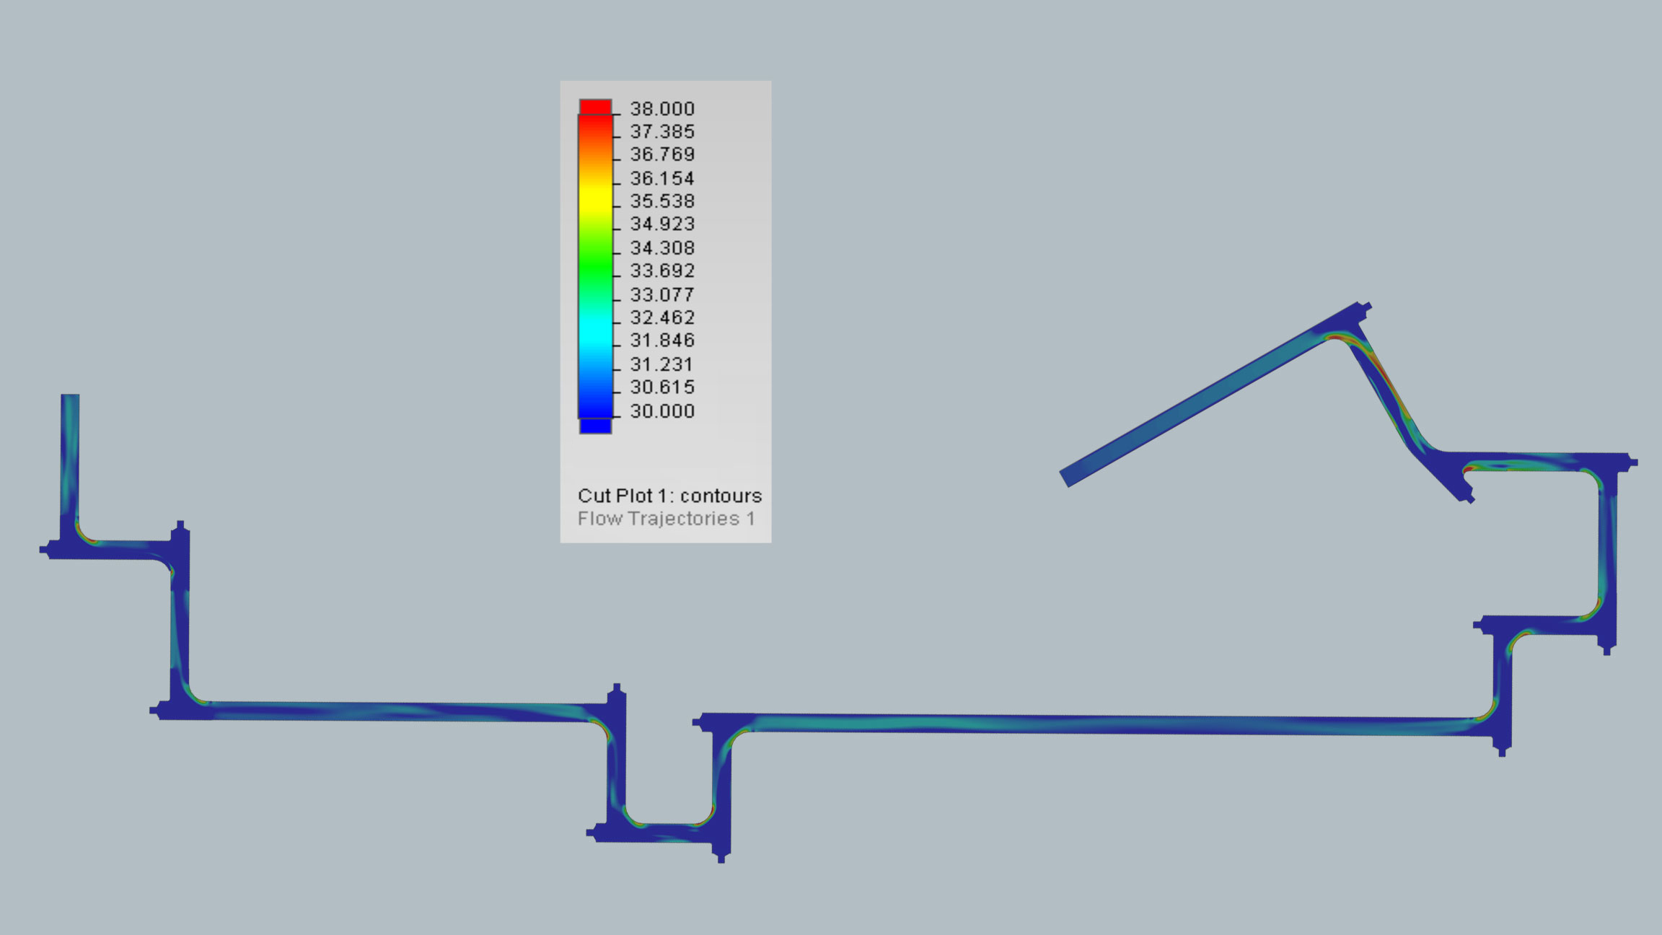

Slide 21
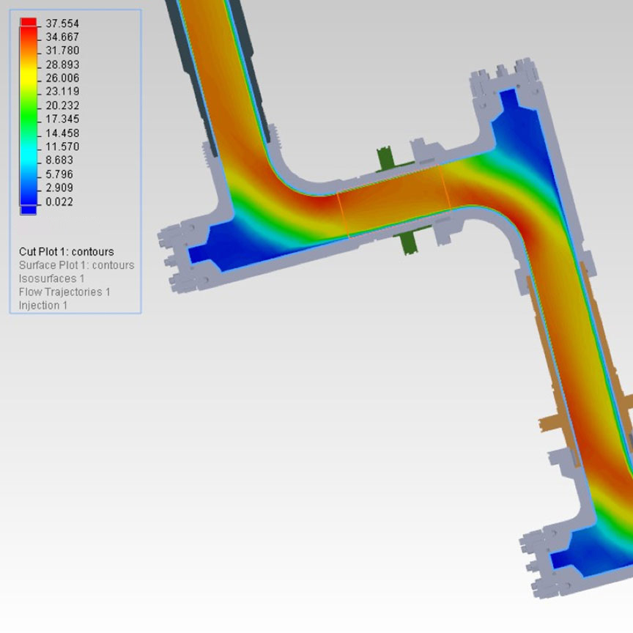
Complete Flow Path Model
20% Reduction of Erosion Velocity
Reduction of Angle of Approach
Balanced Flow Design for the Entire Length

Slide 22
Dynamic Flow Iron Life Estimate

Slide 23
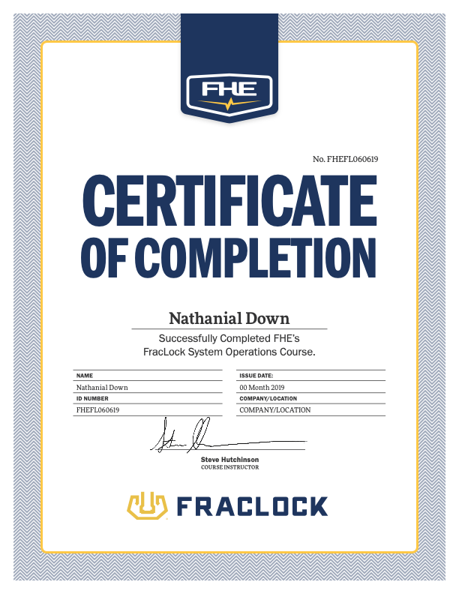
FracLock System Training
40 Hour Training Course
Participants Will Have Classroom Instruction and Hands-On Experience
Certificate of Completion Awarded After Examination

Slide 24
